Slide 1
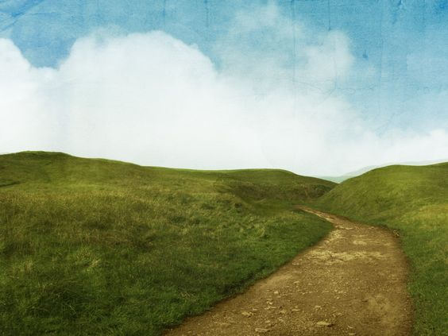
GIVE THANKS

Slide 2
Give thanks with a grateful heart Give thanks to the Holy One Give thanks because He's given
Jesus Christ, His Son

Slide 3
And now let the weak say, "I am strong" Let the poor say, "I am rich Because of what the Lord
has done for us"
Give thanks...

